Slide 1
World Shark Bite Statistics
Katie Leatherman
DSC 530
Final Project

Slide 2
Are shark attacks random?
For this project, I want to consider whether there are specific trends or patterns in shark attack reports. Primarily, are there trends in types of sharks, ages of victims, or where the attacks take place?

Slide 3
Key Variables
Year – Year of a reported attack
Type – Type of attack (provoked, unprovoked, etc)
Country – Country where the attack took place
Area – Area in the country where the attack took place
Activity – What activity was the victim partaking in at the time of the attack
Fatal – Was the attack fatal (yes/no)
Sex – Sex of the victim
Age – Age of the victim
Species – Species of shark that attacked

Slide 4
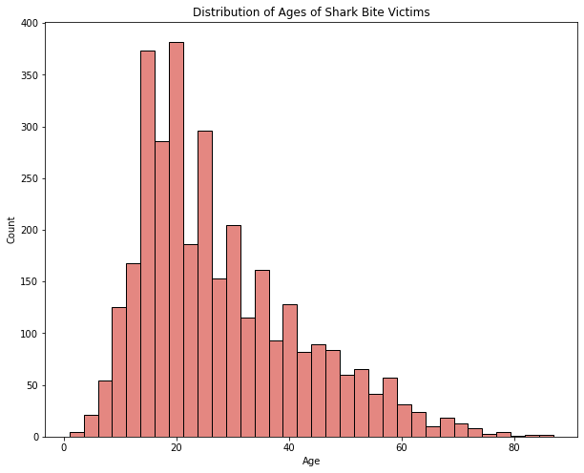
Age
There is a wide range of ages. They are all within reasonable human age ranges. The distribution is right-skewed, and the mean is 28 and the median is 24. There don't seem to be any outliers, but I did drop entries that were not numeric (ie: 'Teen')

Slide 5
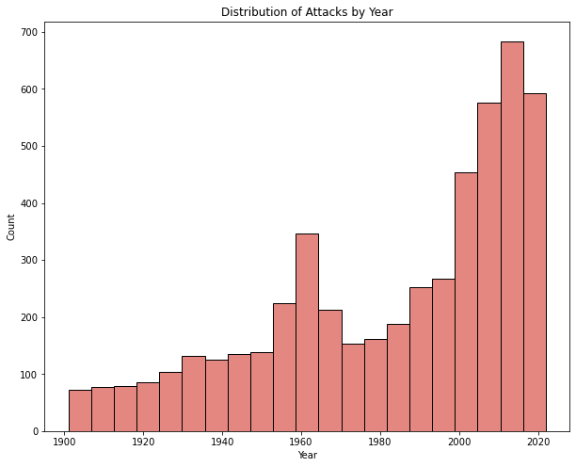
Year
For this range, I chose to only look at 1900-present. There are other, earlier years, but they could have been potential errors (Some were in the 1700s). Reported attacks have been increasing, and the distribution is left-skewed, with the mean as 1982 and the median is 1994.

Slide 6
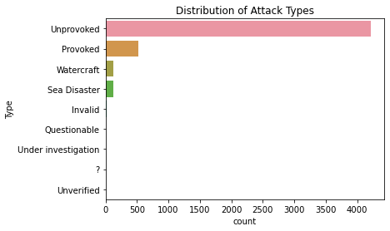
Attack Type
By far, most attacks are unprovoked. Some are provoked, and there are a few outlier that fall under "questionable", "unverified", etc.

Slide 7
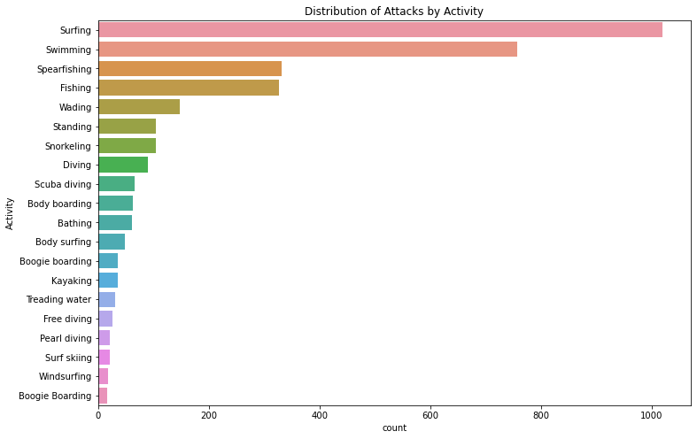
Activity
This graph shows only the top 20 activities listed in the data. There are a lot of descriptions of activities, but these tend to be the most straightforward answers.

Slide 8
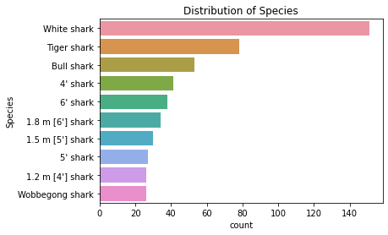
Species
Shark species suffers from a similar problem. There are a lot of different descriptions of the kinds of sharks, and they don't tend to line up much outside of the top 3.

Slide 9
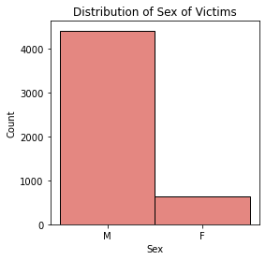
Sex
I also looked at the distribution of the sexes. I excluded outliers that were not M or F. Anything outside of that was a single entry, and probably a typo, rather than a description of gender. We can clearly see that males tend to be the victims.

Slide 10
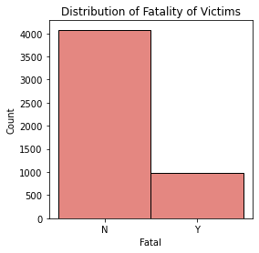
Fatal
I also compared the fatalities from attacks, and overwhelmingly, most attacks are nonfatal.

Slide 11
Descriptive Statistics
Year
Mean: 1983.3
Standard Deviation: 32.1
Median: 1994
Range: 1901-2022
Age
Mean: 27.9
Standard Deviation: 14.35
Median: 24
Range: 1-87

Slide 12
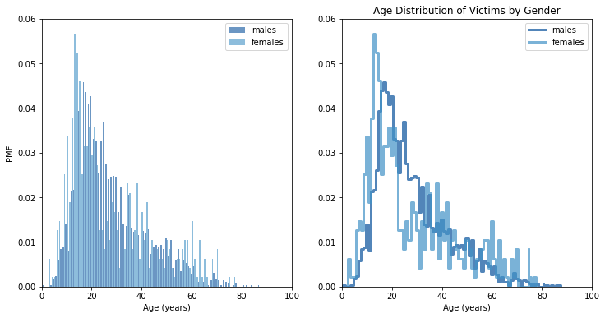
Comparing PMFs
I separated my data by gender, and then compared the age of victims. Generally, the trends are the same, both genders peak around 20.

Slide 13
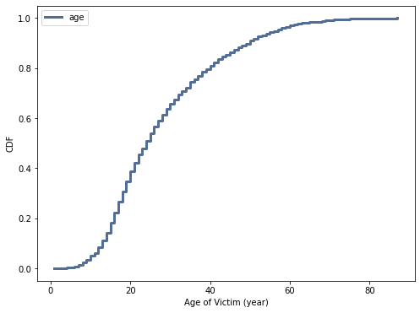
CDF of Victim Ages
From this CDF of victim ages, we can see that this is a distribution that increases the most from mid-teens to around 40. After that, the slope decreases dramatically.

Slide 14
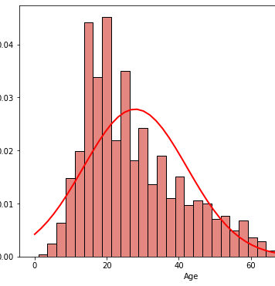
Comparing Age Distribution to Normal Distribution
Here, I have graphed a normal distribution based on the mean and standard distribution curve on top of the actual data. We can see that the peaks are close but not on top of each other, but otherwise the shape of the distribution is very similar, so a normal distribution is a usable model for this data.

Slide 15
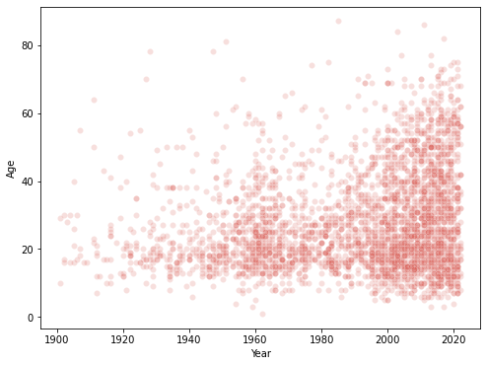
Scatterplot of Year vs Age
We can see that over time, 20 is the general age of someone to get hurt by a shark. As time goes on, more older people are being injured. This might be because of extended lifespans, and the ability to be in the water at those ages, due to medical advances. As time goes on, more younger ages are likely to get injured as well. This might be because of expanded access for families to beaches, whether physically or economically. Either way, I think it's more likely that the increase in range of ages is due to accesibility of getting to the water instead of sharks targeting a wider range of people.
There is a positive correlation, but it is weak. Covariance shows a positive relationship, but Pearson's R is .1958, confirming that the relationship is weak, since it is so close to 0.

Slide 16
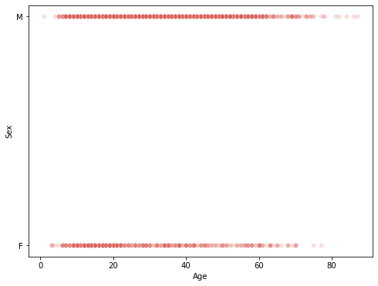
Scatterplot of Age vs Sex
The other available variables in this dataset are boolean or categorical, so there is not a lot of information we can gain from them. By separating by gender, though, we can see that women are less likely to be attacked as they get older.

Slide 17
T-test for the age of victims due to Sex
Running an independent t-test on the means of male and female victim's age, we get a t-statistic of .8936, and a p-value of .3715. This tells us that there is a shown difference between the mean ages based on sex, larger than our variability would have predicted. But our p-value tells us that there is a large chance this could have happened randomly, so this finding is not statistically significant.

Slide 18
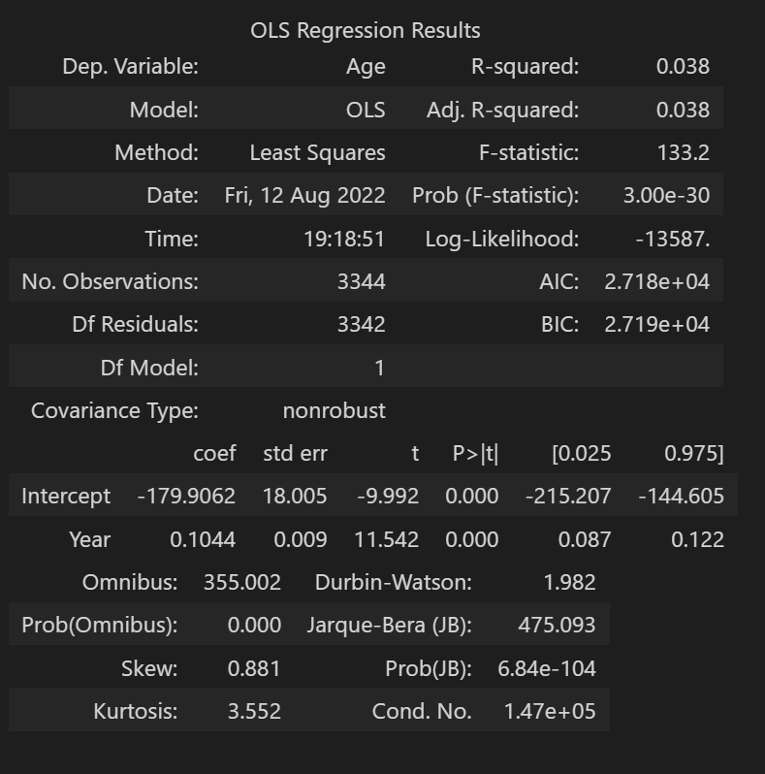
Regression Analysis
For a regression analysis, I looked at Year as a predictor of Age of victim.
R² value is low, so there is not a lot of effect from Year on Age.
Overall, this is not a reliable model to predict age of victims.

